Slide 1
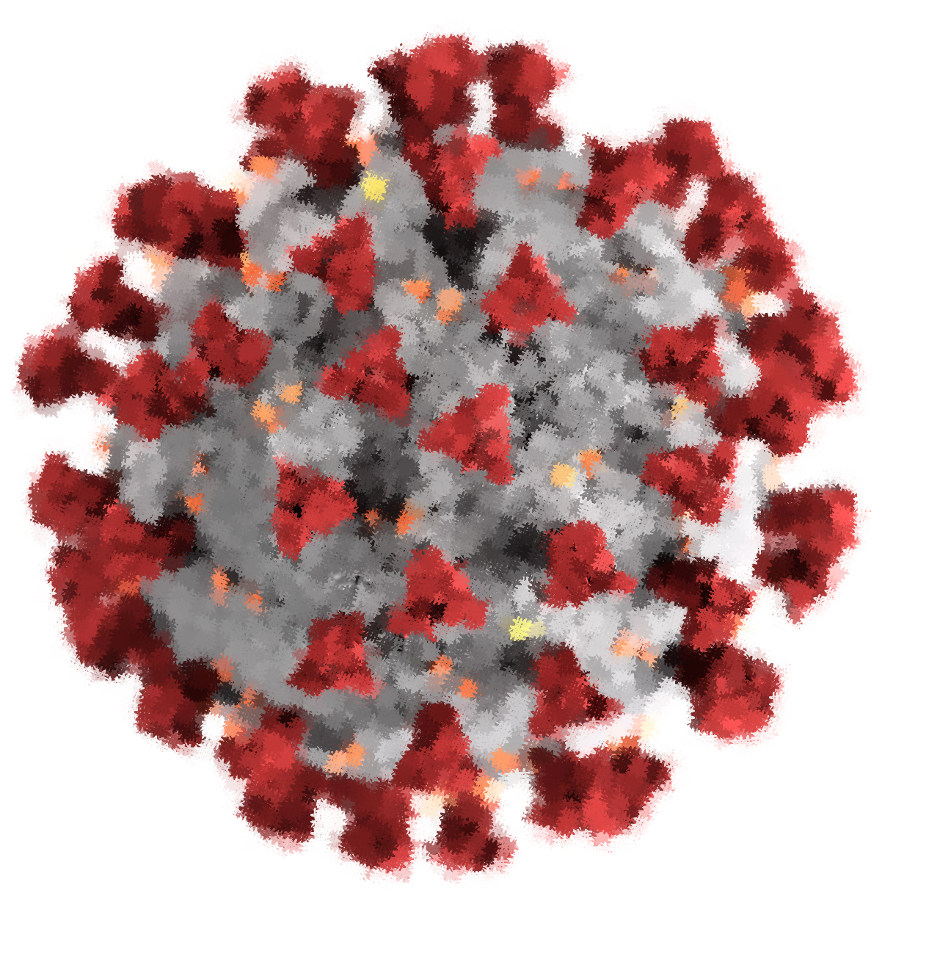
, XGBoost and SVM
Covid-19
Data analysis and performance comparison of forecasting algorithms
Krithikashree – Jahanvi – Prananditha

Slide 2
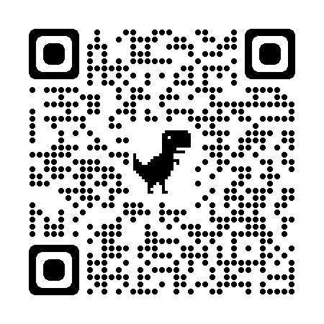
About the project
SCAN ME !!

Slide 3



Problem Statement
Notes:
Current issue
How ML can be useful here
Underlying problem
Proposed method and its usefulness

Slide 4
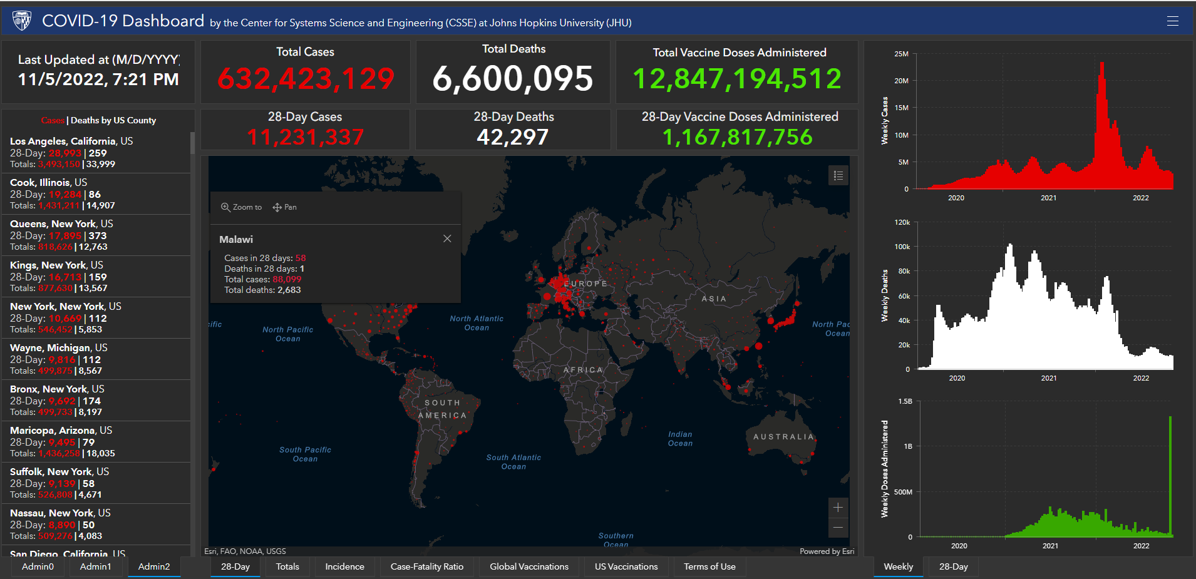
About the dataset

Slide 5
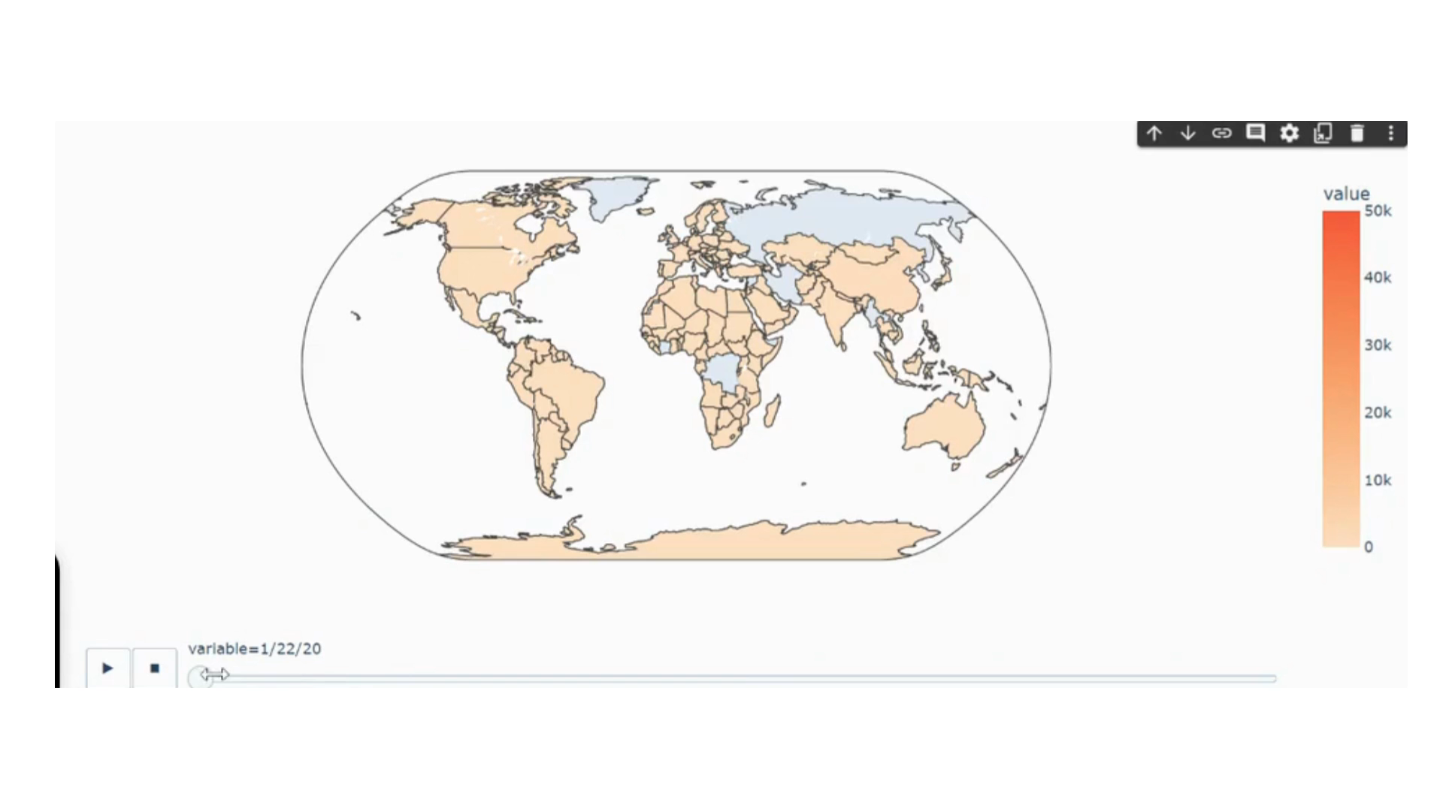
Analysis of the dataset

Slide 6
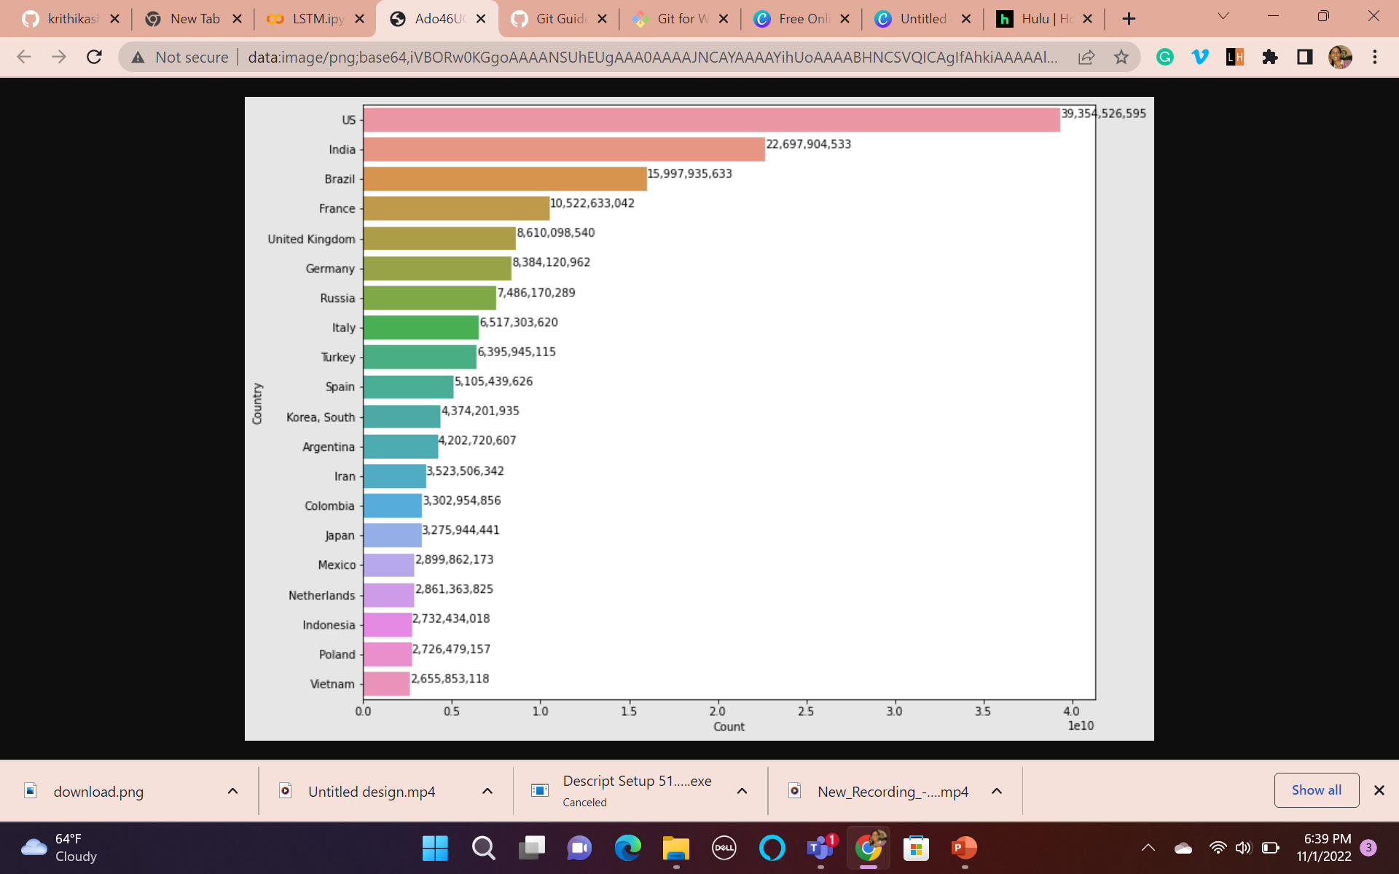
Analysis of the dataset

Slide 7
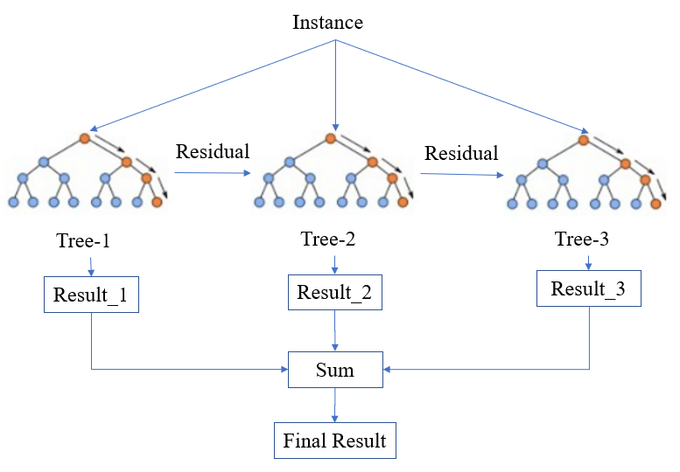
XGBOOST

Slide 8
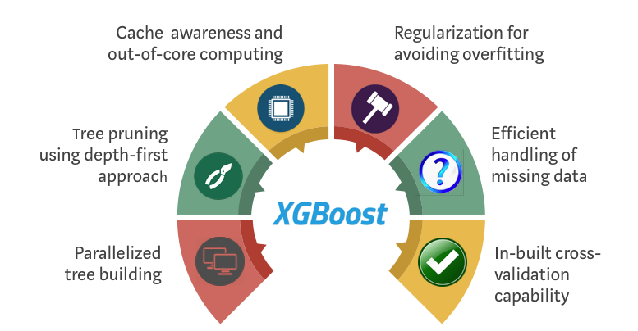
Why XGBOOST

Slide 9
Literature review
Short Term Load Forecasting Using XGBoost
Time series forecast of sales volume based on XGBoost

Slide 10
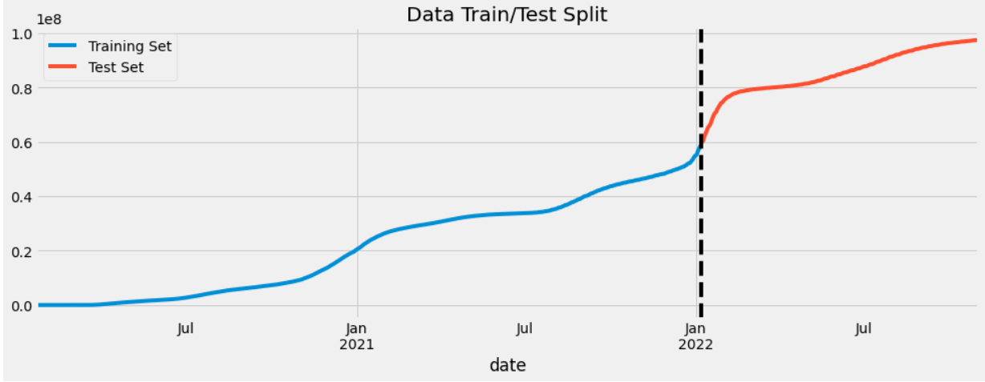
Current Trend and Train ,Test Split

Slide 11
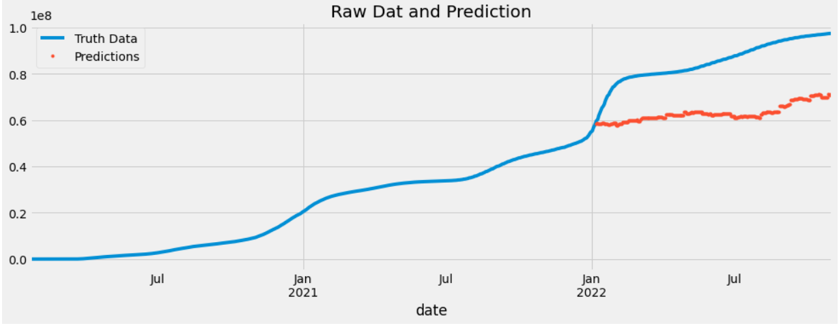
Model Evaluation
Validation RMSE:2.30726e+07

Slide 12
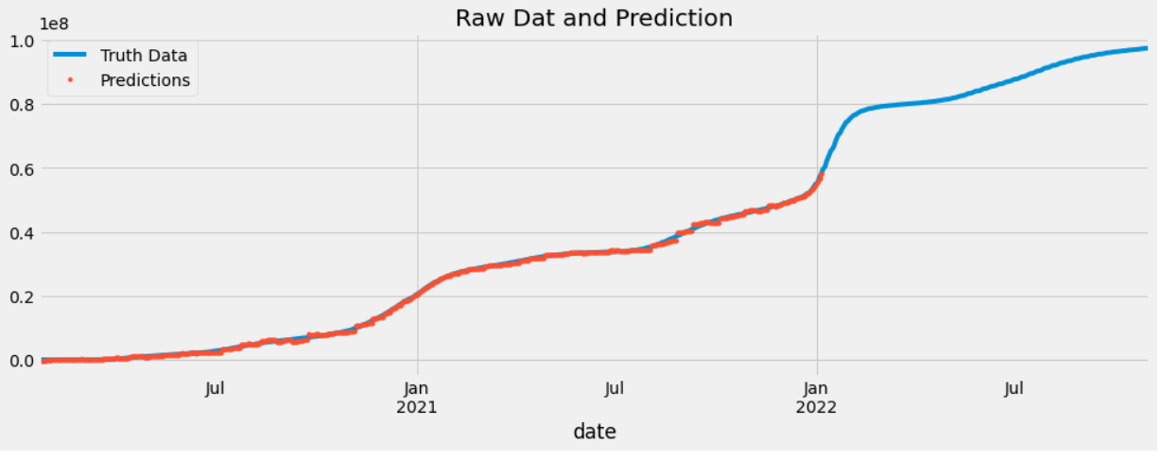

Slide 13
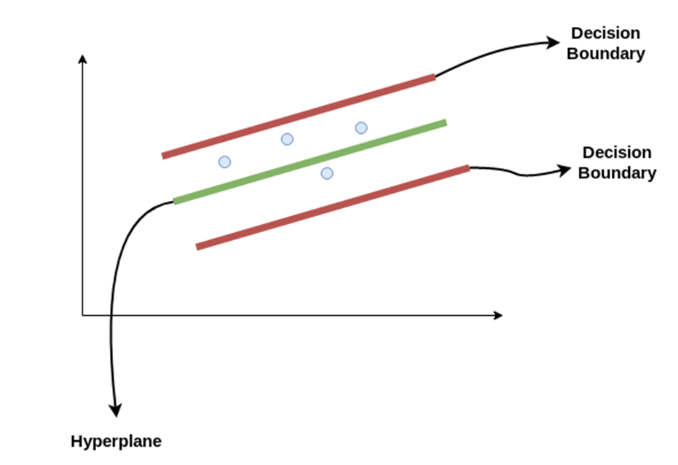

Support Vector Regression
SVM find a plane that has the maximum margin, i.e the maximum distance between data points of both classes.
What if we use the plane as a regression line?

Slide 14
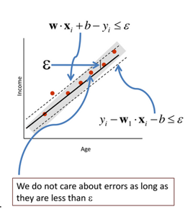
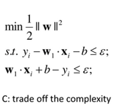
Support Vector Regression
Unlike other Regression models that try to minimize the error between the real and predicted value, the SVR tries to fit the best line within a threshold value. The threshold value is the distance between the hyperplane and boundary line.
The problem can be written as:

Slide 15
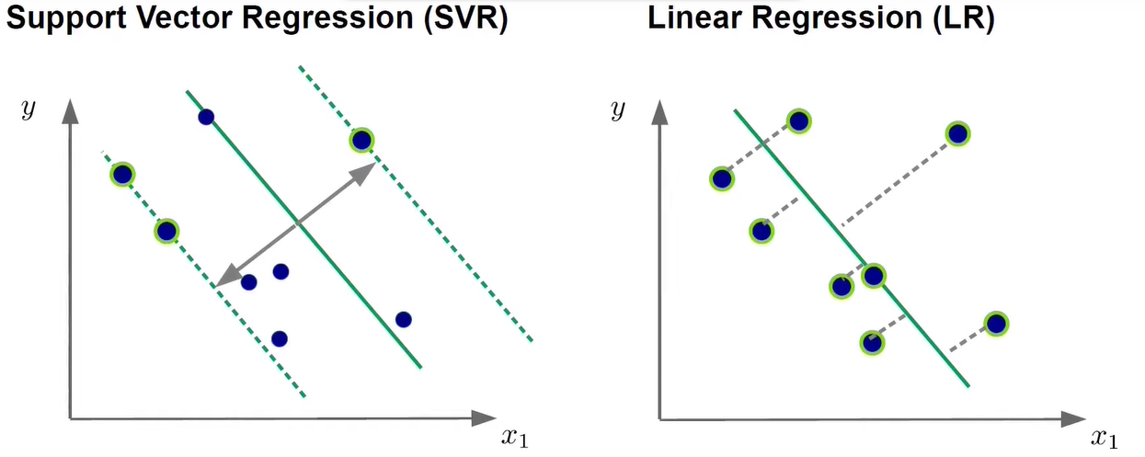
Why Support Vector Regression?

Slide 16
Literature review
SUPPORT VECTOR REGRESSION FOR PREDICTING COVID-19 CASES
Time series forecasting by a seasonal support vector regression model

Slide 17
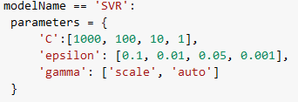
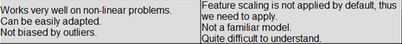
Remarks

Slide 18
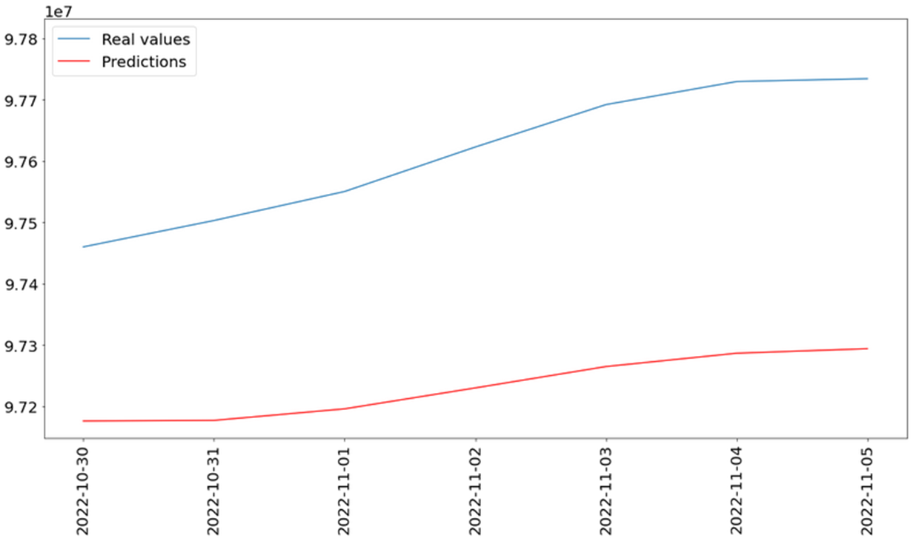
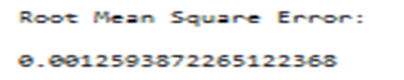
Support Vector Regression Evaluation:
Fig: Evaluating COVID-19 cases on past 7 days

Slide 19
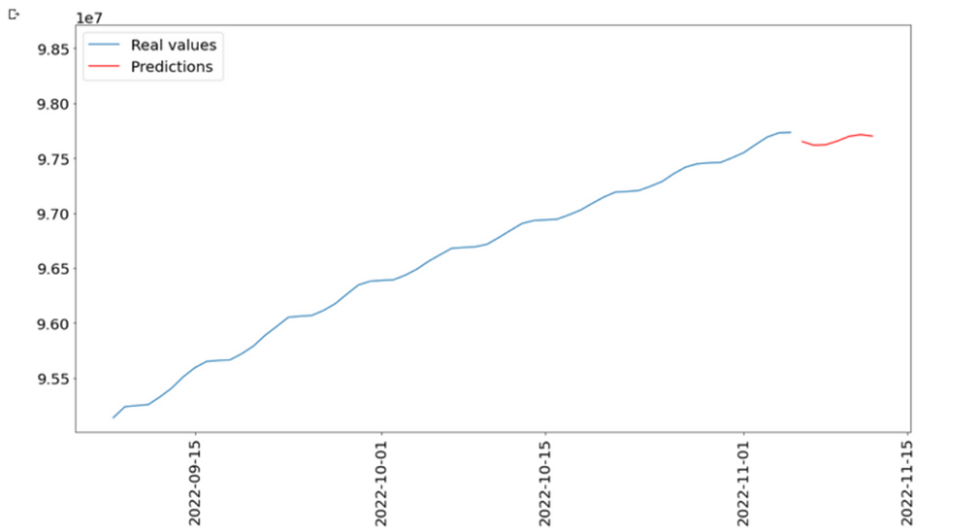
Support Vector Regression Results:
Fig: Forecasting COVID-19 cases for next 7 days

Slide 20

LSTM and Why LSTM
Pattern
RNN
LSTM
Time series
Notes:
Every infectious disease outbreak exhibits certain patterns and such patterns needed to be identified based on transmission dynamics of such outbreaks. Intervening measures to eradicate such infectious diseases rely on the methods used to evaluate the outbreak when it occurs. Usually patterns exhibited in such scenarios are non-linear in nature and this motivates us to design the system that can capture such non-linear dynamic changes.
Given data is a time series. The best solution here would be to use neural network
Issues with RNN
So we end-up choosing LSTM

Slide 21
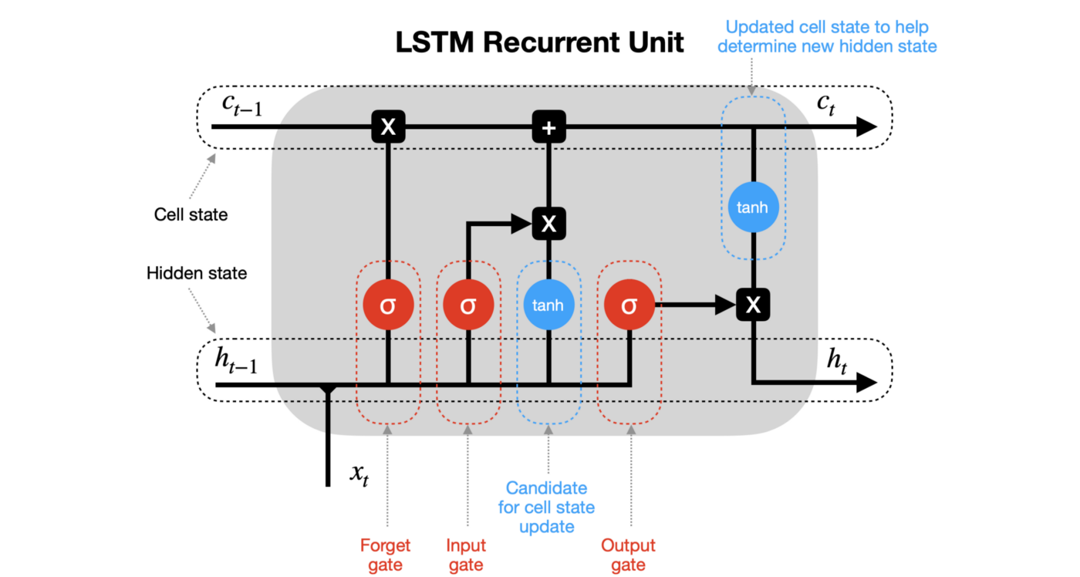
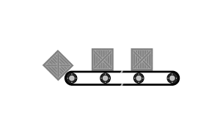

LOOKS COMPLEX?
Notes:
https://intellipaat.com/blog/what-is-lstm/

Slide 22
Literature review
Time series forecasting of COVID-19 transmission in Canada using LSTM networks
Time series forecasting of Covid-19 using deep learning models: India-USA comparative case study
Notes:
https://www.sciencedirect.com/science/article/pii/S0960077920302642?casa_token=EdD82_4Fi_IAAAAA:GsVmOQ3JaZZKWS-93M8NCaW_TctpvSsHUXwoSvw6ywIrmn2hywMI6w9d3h6kfPf80-OpMvxU8AQ#aep-article-footnote-id1
https://www.ncbi.nlm.nih.gov/pmc/articles/PMC7440083/

Slide 23
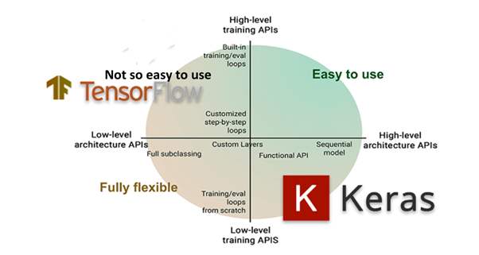

LSTM model
Sequential way of building deep learning networks
LSTM model and Dense layer
UPGRADE the model
Notes:
https://www.educba.com/keras-lstm/
https://towardsdatascience.com/walking-through-support-vector-regression-and-lstms-with-stock-price-prediction-45e11b620650

Slide 24
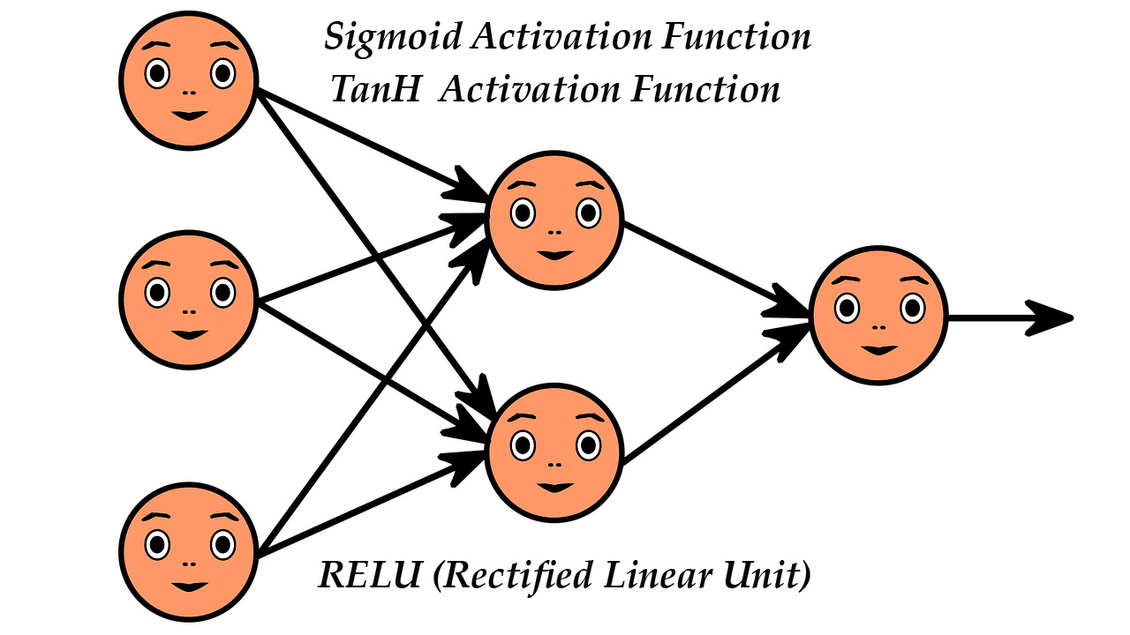
The upgrade
Notes:
https://www.aitude.com/comparison-of-sigmoid-tanh-and-relu-activation-functions/#:~:text=ReLu%20is%20the%20best%20and,compare%20to%20other%20activation%20function.
COMPUTATIONAL SPEED
VANISHING GRADIENT
BUT FAST CONVERGENCE

Slide 25
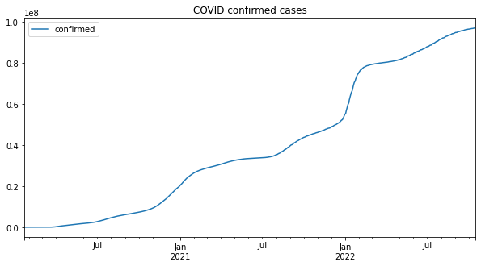
Current Trend
If the prediction is as expected, we would expect the output to be here

Slide 26
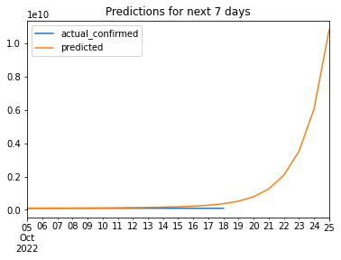
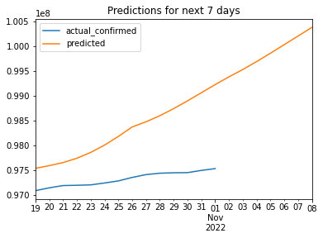
Future Forecast

Slide 27
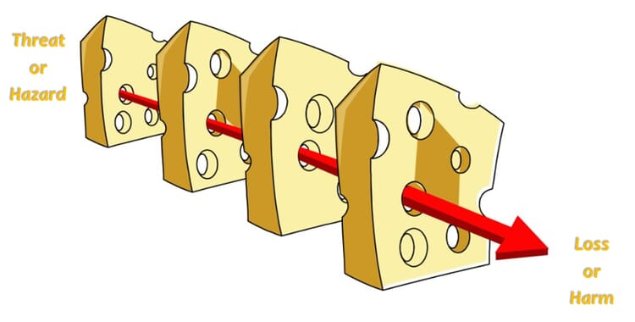
Model Evaluation
What does this say about the forcast?
Train-loss: 5.4708e-05
Test-loss: 3.6033e-05

Slide 28





Comparison and Conclusion
Challenging
Long term dependencies
LSTM
Dataset size
Linearity
Notes:
https://datascience.stackexchange.com/questions/54657/which-performs-better-in-time-series-forecasting-lstm-or-svr

Slide 29





Comparison and Conclusion
Feature engineering
Speed
Overfitting
Hardware requirements
Notes:
https://datascience.stackexchange.com/questions/54657/which-performs-better-in-time-series-forecasting-lstm-or-svr

Slide 30
Demo
XGBOOST DEMO
SVR DEMO
LSTM DEMO

